Slide 1
Hashing
Data Structures and Algorithms
Nanjing University, Fall 2024
郑朝栋

Slide 2
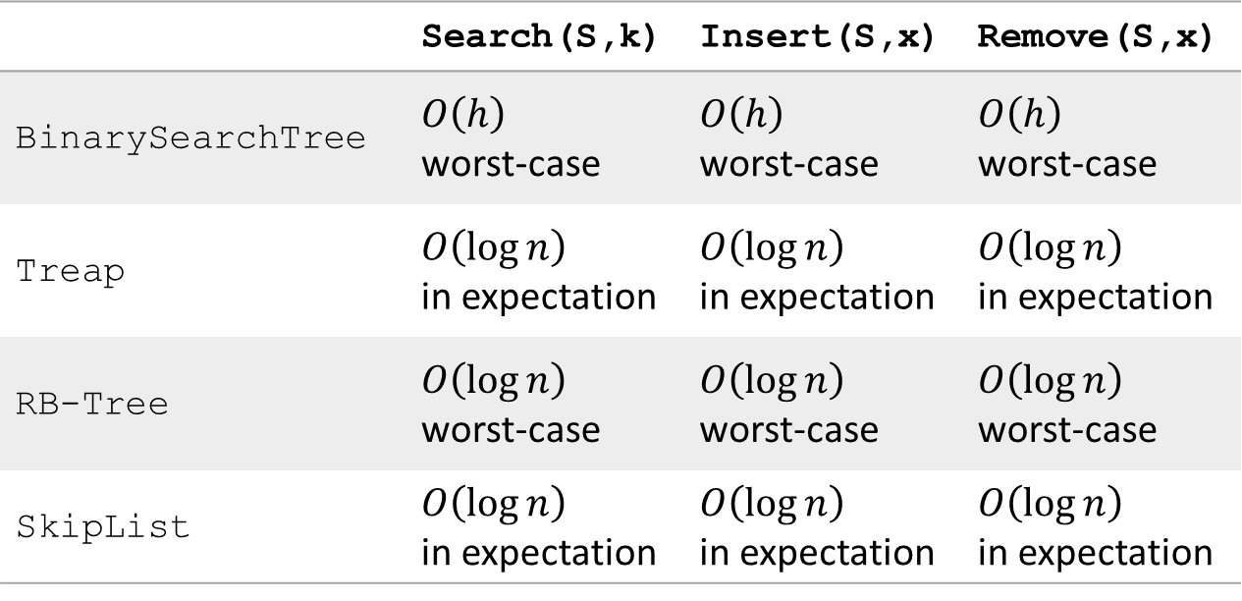
Efficient implementation of OSet
 | Search(S,k) | Insert(S,x) | Remove(S,x)
BinarySearchTree | $O\left(h\right)$ worst-case | $O\left(h\right)$ worst-case | $O\left(h\right)$ worst-case
Treap | $O\left(\log{n}\right)$ in expectation | $O\left(\log{n}\right)$ in expectation | $O\left(\log{n}\right)$ in expectation
RB-Tree | $O\left(\log{n}\right)$ worst-case | $O\left(\log{n}\right)$ worst-case | $O\left(\log{n}\right)$ worst-case
SkipList | $O\left(\log{n}\right)$ in expectation | $O\left(\log{n}\right)$ in expectation | $O\left(\log{n}\right)$ in expectation
Can we be faster?
(if we only care about Search/Insert/Remove)

Slide 3

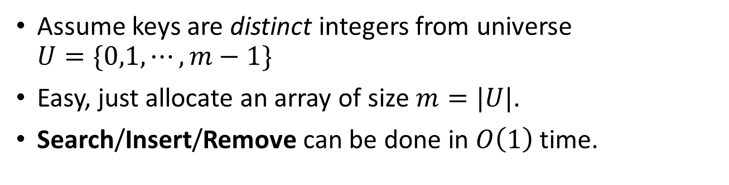
Search/Insert/Remove in $O(1)$ time
Assume keys are distinct integers from universe $U=\{0,1,⋯,m−1\}$
Easy, just allocate an array of size $m=|U|$.
Search/Insert/Remove can be done in $O\left(1\right)$ time.
Direct-address Tables
Insert(2)
0
Any potential issue?
Insert(3)
1
Search(2)
2
2
Remove(3)
3
3
Search(3)
4
5
Notes:
Direct-address table: 直接寻址表

Slide 4
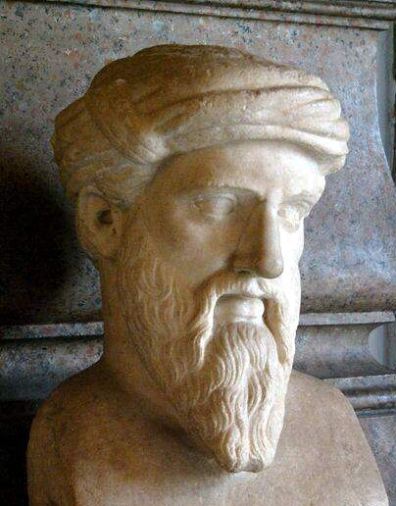
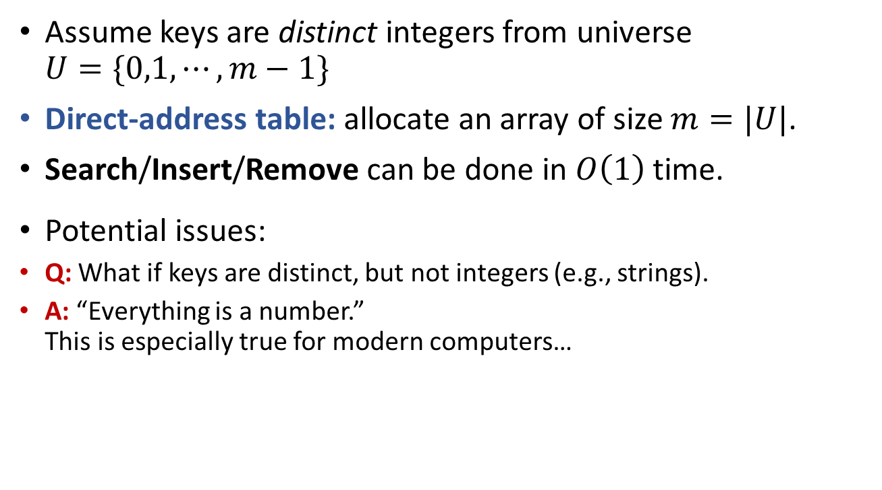
Direct-address Tables
Assume keys are distinct integers from universe $U=\{0,1,⋯,m−1\}$
Direct-address table: allocate an array of size $m=|U|$.
Search/Insert/Remove can be done in $O\left(1\right)$ time.
Potential issues:
Q: What if keys are distinct, but not integers (e.g., strings).
A: “Everything is a number.” This is especially true for modern computers…
Said Πυθαγόρας.
That is, Pythagoras.

Slide 5
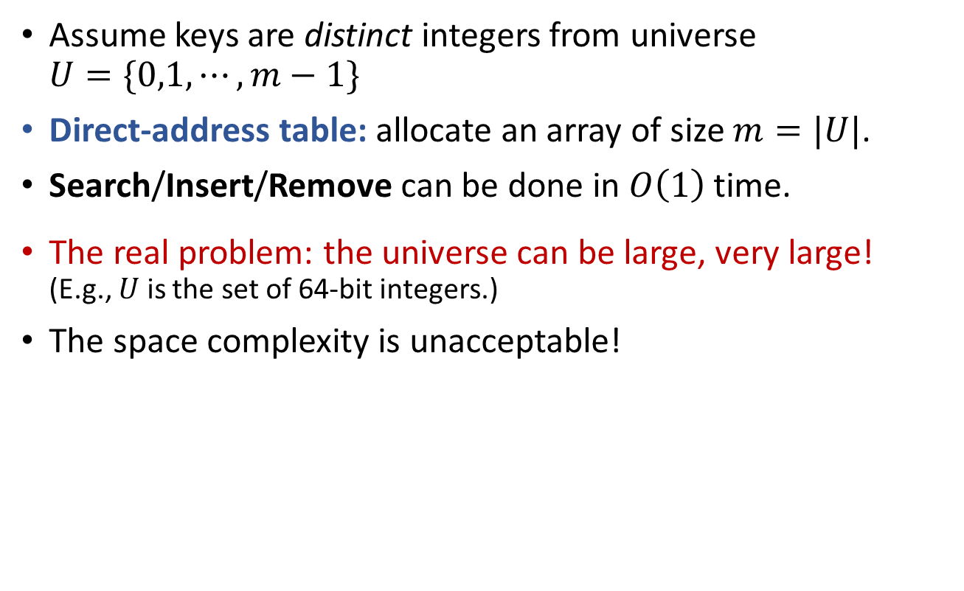
Direct-address Tables
Assume keys are distinct integers from universe $U=\{0,1,⋯,m−1\}$
Direct-address table: allocate an array of size $m=|U|$.
Search/Insert/Remove can be done in $O\left(1\right)$ time.
The real problem: the universe can be large, very large! (E.g., $U$ is the set of 64-bit integers.)
The space complexity is unacceptable!

Slide 6
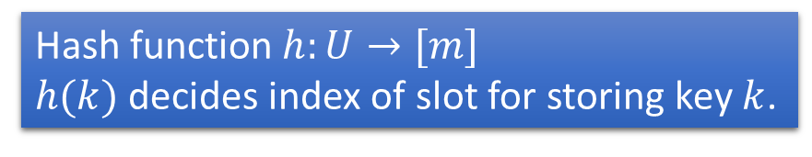



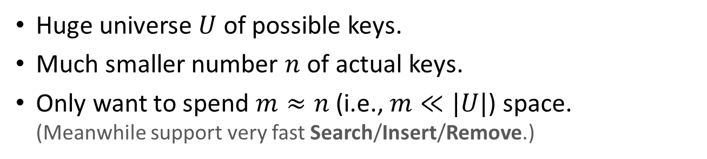






Hashing
Huge universe $U$ of possible keys.
Much smaller number $n$ of actual keys.
Only want to spend $m≈n$ (i.e., $m≪|U|$) space. (Meanwhile support very fast Search/Insert/Remove.)
Hash function $h:U→[m]$
$h(k)$ decides index of slot for storing key $k$.
$$U$$
3
0
$$h\left(x\right)=0$$
1
$$h\left(u\right)=2$$
2
$$x$$
$$u$$
3
3
$$y$$
$$h\left(y\right)=5$$
4
5
$$w$$
3
6
$$h\left(w\right)=8$$
7
8

Slide 7
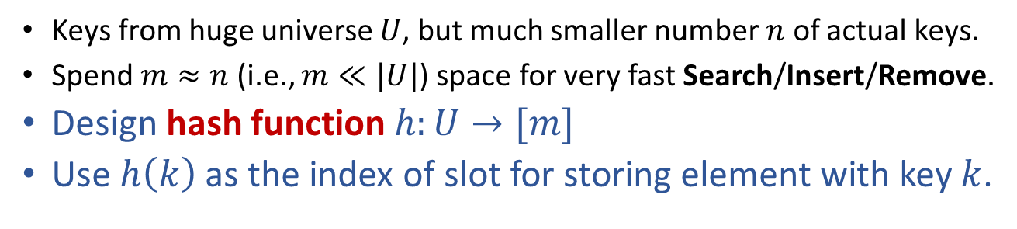
Hashing
Keys from huge universe $U$, but much smaller number $n$ of actual keys.
Spend $m≈n$ (i.e., $m≪|U|$) space for very fast Search/Insert/Remove.
Design hash function $h:U→[m]$
Use $h\left(k\right)$ as the index of slot for storing element with key $k$.
Hashing “randomly” maps keys to buckets
$$U$$
3
0
$$h\left(x\right)=0$$
1
$$h\left(u\right)=2$$
2
$$x$$
$$u$$
3
3
$$y$$
$$h\left(y\right)=5$$
4
5
$$w$$
3
6
$$h\left(w\right)=8$$
7
8

Slide 8

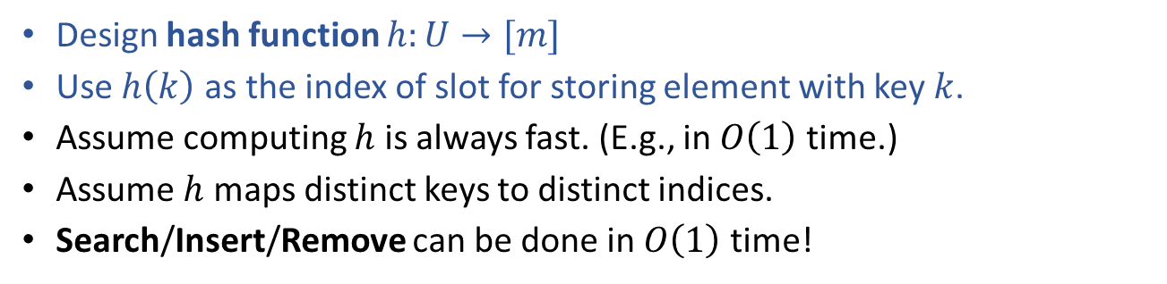
Hashing
$$m≪|U|$$
Design hash function $h:U→[m]$
Use $h\left(k\right)$ as the index of slot for storing element with key $k$.
Assume computing $h$ is always fast. (E.g., in $O\left(1\right)$ time.)
Assume $h$ maps distinct keys to distinct indices.
Search/Insert/Remove can be done in $O\left(1\right)$ time!
But is this possible?
NO!!!
$$U$$
3
0
$$h\left(x\right)=0$$
1
$$h\left(u\right)=2$$
2
$$x$$
$$u$$
3
3
$$y$$
$$h\left(y\right)=5$$
4
5
$$w$$
3
6
$$h\left(w\right)=8$$
7
8

Slide 9



Collisions in hashing
Hash function $h:U→[m]$
Two distinct keys $k_{1}$ and $k_{2}$ collide if: $h\left(k_{1}\right)=h\left(k_{2}\right)$
Collisions are unavoidable!
Proof: $m≪|U|$ and pigeonhole principle.
How to cope with collisions?
$$U$$
3
0
$$h\left(x\right)=0$$
1
$$h\left(u\right)=2$$
2
$$x$$
$$u$$
3
3
$$y$$
$$h\left(y\right)=5$$
4
5
$$z$$
$$h\left(z\right)=8$$
$$w$$
3
6
$$h\left(w\right)=8$$
7
8

Slide 10






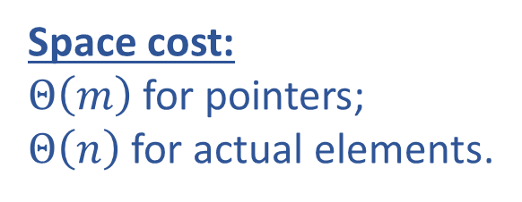


Coping with collisions in hashing Chaining
Each bucket $i$ stores a pointer to a linked list $L_{i}$.
All keys that are hashed to index $i$ go to $L_{i}$.
Hash Table
0
3
$$h\left(k_{4}\right)=h\left(k_{5}\right)=h\left(k_{6}\right)=2$$
1
2
$$k_{6}$$
$$k_{5}$$
$$k_{4}$$
3
3
Space cost:
$Θ\left(m\right)$ for pointers;
$Θ\left(n\right)$ for actual elements.
4
5
$$k_{1}$$
6
3
7
8
$$k_{3}$$
$$k_{2}$$

Slide 11

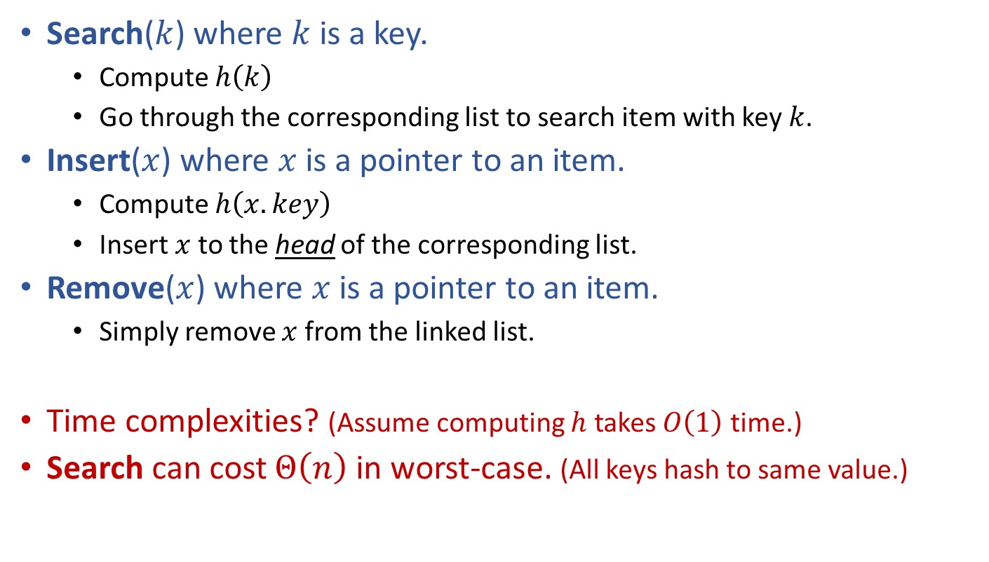

Hashing with Chaining
Search($k$) where $k$ is a key.
Compute $h\left(k\right)$
Go through the corresponding list to search item with key $k$.
Insert($x$) where $x$ is a pointer to an item.
Compute $h\left(x.key\right)$
Insert $x$ to the head of the corresponding list.
Remove($x$) where $x$ is a pointer to an item.
Simply remove $x$ from the linked list.
Time complexities? (Assume computing $h$ takes $O\left(1\right)$ time.)
Search can cost $Θ\left(n\right)$ in worst-case. (All keys hash to same value.)
Time depends on length of the linked list!
$$O(1)$$
$$O(1)$$

Slide 12
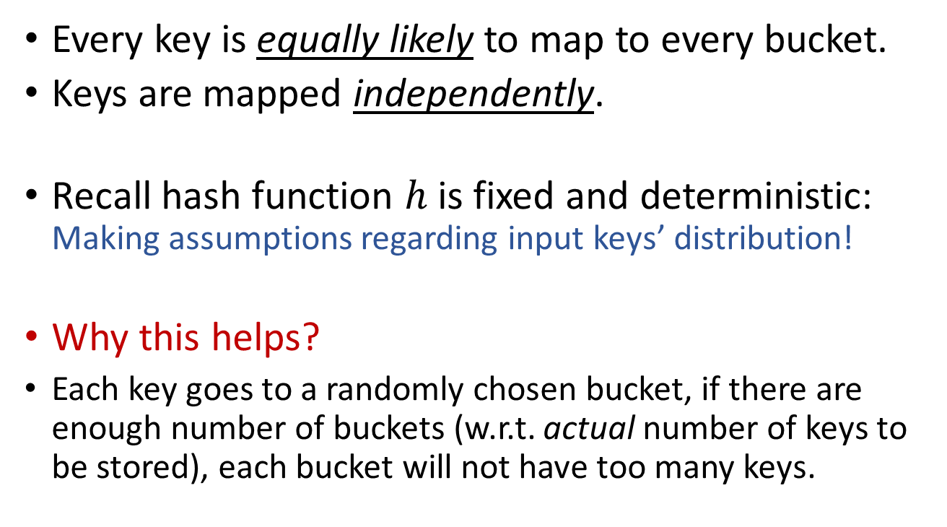
Let’s be optimistic (for now): The “Simple Uniform Hashing” Assumption
Every key is equally likely to map to every bucket.
Keys are mapped independently.
Recall hash function $h$ is fixed and deterministic: Making assumptions regarding input keys’ distribution!
Why this helps?
Each key goes to a randomly chosen bucket, if there are enough number of buckets (w.r.t. actual number of keys to be stored), each bucket will not have too many keys.

Slide 13
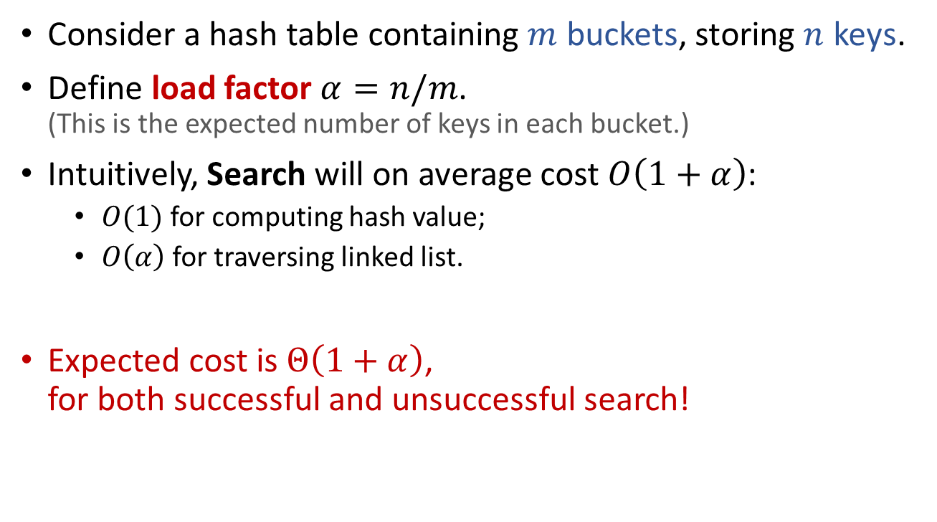
Assuming “Simple Uniform Hashing” Performance of hashing with chaining
Consider a hash table containing $m$ buckets, storing $n$ keys.
Define load factor $α=n/m$. (This is the expected number of keys in each bucket.)
Intuitively, Search will on average cost $O\left(1+α\right)$:
$O(1)$ for computing hash value;
$O\left(α\right)$ for traversing linked list.
Expected cost is $Θ\left(1+α\right)$, for both successful and unsuccessful search!

Slide 14
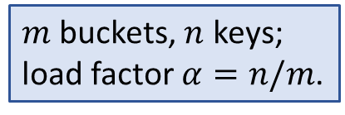
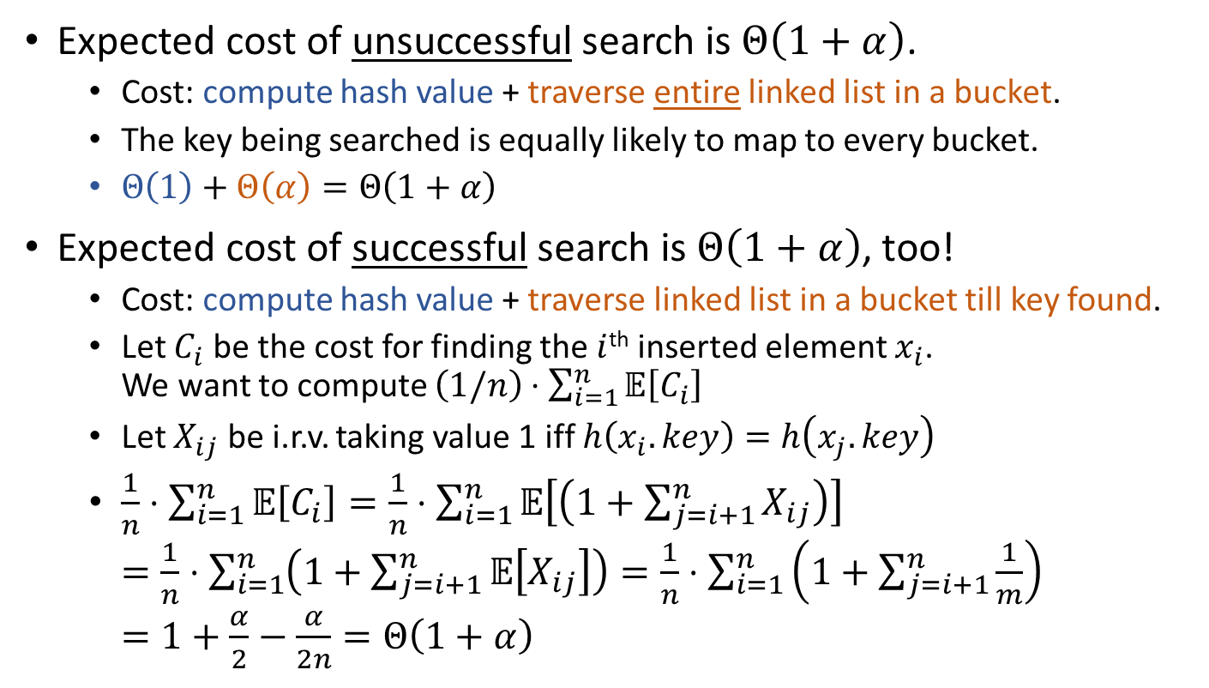
Assuming “Simple Uniform Hashing” Performance of hashing with chaining
$m$ buckets, $n$ keys; load factor $α=n/m$.
Expected cost of unsuccessful search is $Θ\left(1+α\right)$.
Cost: compute hash value + traverse entire linked list in a bucket.
The key being searched is equally likely to map to every bucket.
$Θ\left(1\right)+Θ\left(α\right)=Θ\left(1+α\right)$
Expected cost of successful search is $Θ\left(1+α\right)$, too!
Cost: compute hash value + traverse linked list in a bucket till key found.
Let $C_{i}$ be the cost for finding the $i$^{th} inserted element $x_{i}$. We want to compute $\left(1/n\right)⋅\sum_{i=1}^{n}{𝔼\left[C_{i}\right]}$
Let $X_{ij}$ be i.r.v. taking value 1 iff $h\left(x_{i}.key\right)=h\left(x_{j}.key\right)$
$\frac{1}{n}⋅\sum_{i=1}^{n}{𝔼\left[C_{i}\right]}=\frac{1}{n}⋅\sum_{i=1}^{n}{𝔼\left[\left(1+\sum_{j=i+1}^{n}{X_{ij}}\right)\right]}$ $=\frac{1}{n}⋅\sum_{i=1}^{n}{\left(1+\sum_{j=i+1}^{n}{𝔼\left[X_{ij}\right]}\right)}=\frac{1}{n}⋅\sum_{i=1}^{n}{\left(1+\sum_{j=i+1}^{n}{\frac{1}{m}}\right)}$ $=1+\frac{α}{2}−\frac{α}{2n}=Θ\left(1+α\right)$

Slide 15
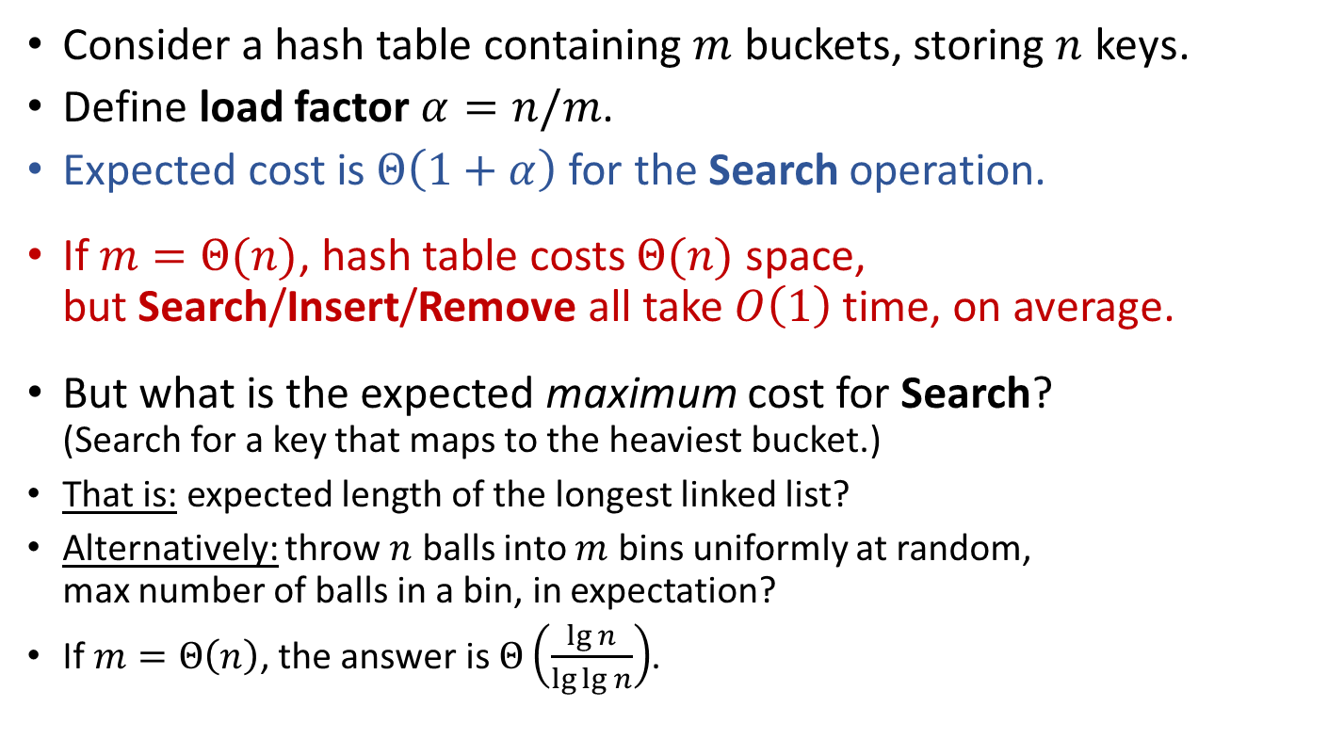
Assuming “Simple Uniform Hashing” Performance of hashing with chaining
Consider a hash table containing $m$ buckets, storing $n$ keys.
Define load factor $α=n/m$.
Expected cost is $Θ\left(1+α\right)$ for the Search operation.
If $m=Θ(n)$, hash table costs $Θ(n)$ space, but Search/Insert/Remove all take $O\left(1\right)$ time, on average.
But what is the expected maximum cost for Search? (Search for a key that maps to the heaviest bucket.)
That is: expected length of the longest linked list?
Alternatively: throw $n$ balls into $m$ bins uniformly at random, max number of balls in a bin, in expectation?
If $m=Θ\left(n\right)$, the answer is $Θ\left(\frac{\lg{n}}{\lg{\lg{n}}}\right)$.

Slide 16
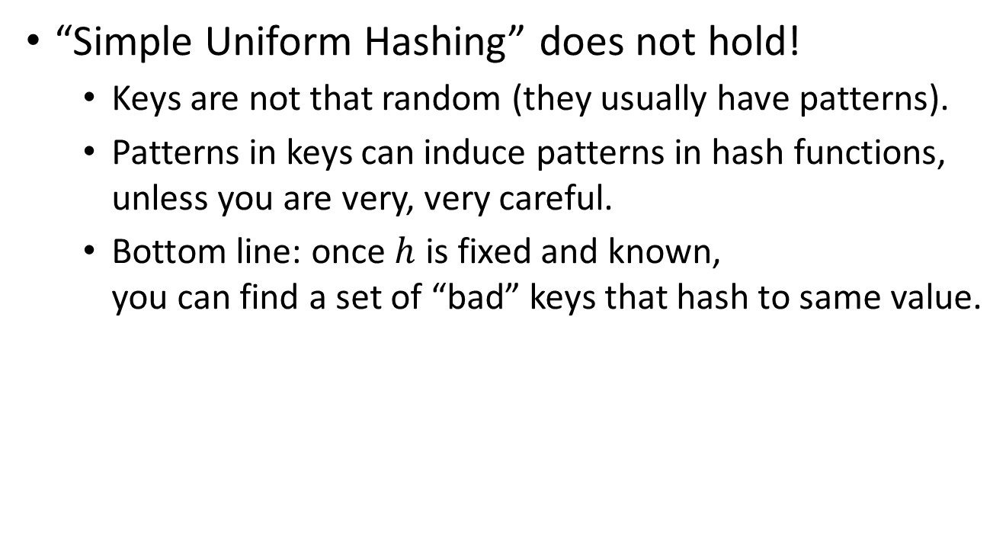
Reality fights back
“Simple Uniform Hashing” does not hold!
Keys are not that random (they usually have patterns).
Patterns in keys can induce patterns in hash functions, unless you are very, very careful.
Bottom line: once $h$ is fixed and known, you can find a set of “bad” keys that hash to same value.

Slide 17
How to design hash functions?
Stop! Please don’t try!
Unless you really need to…
We will now show you this is really not easy...

Slide 18
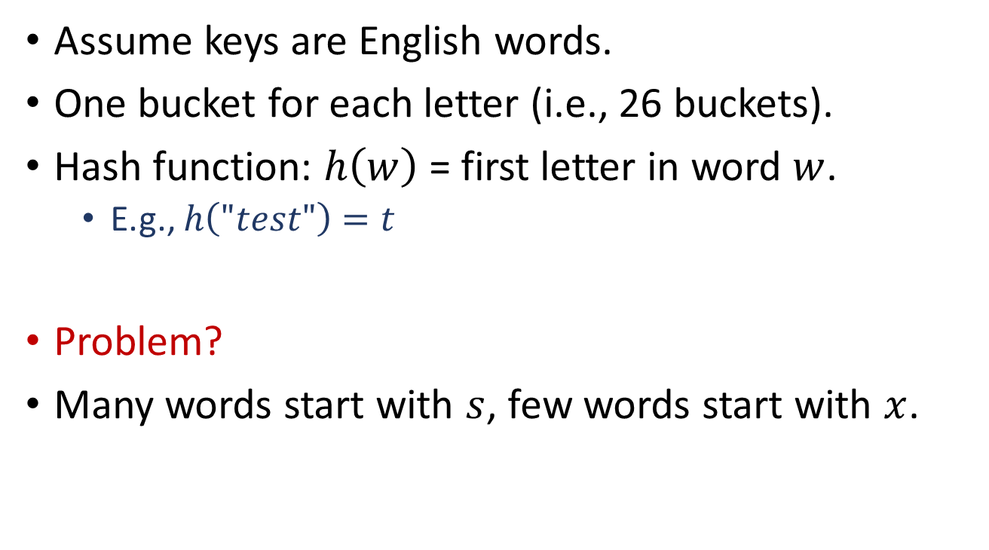
Designing hash functions Some bad hash functions
Assume keys are English words.
One bucket for each letter (i.e., 26 buckets).
Hash function: $h\left(w\right)$ = first letter in word $w$.
E.g., $h\left("test"\right)=t$
Problem?
Many words start with $s$, few words start with $x$.

Slide 19
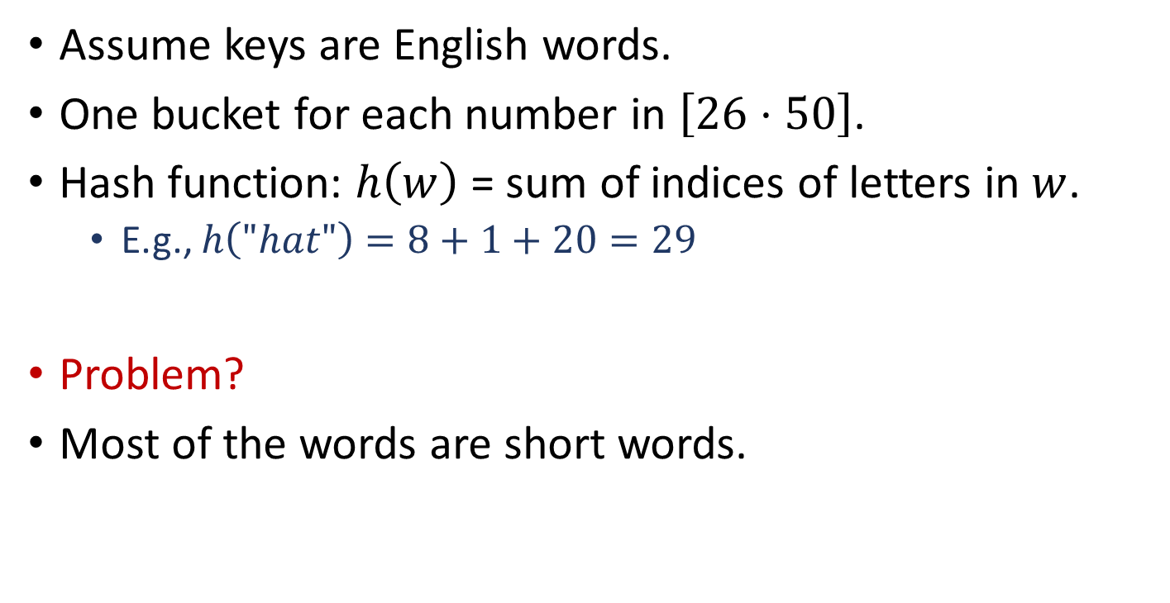
Designing hash functions Some bad hash functions
Assume keys are English words.
One bucket for each number in $\left[26⋅50\right]$.
Hash function: $h\left(w\right)$ = sum of indices of letters in $w$.
E.g., $h\left("hat"\right)=8+1+20=29$
Problem?
Most of the words are short words.

Slide 20
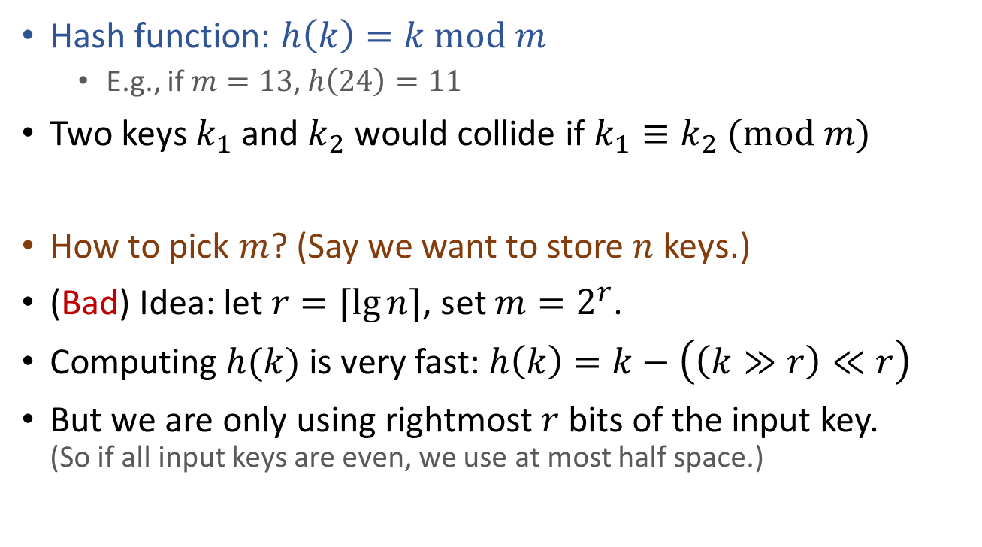
Common technique when designing hash functions The Division Method
Hash function: $h\left(k\right)=k mod m$
E.g., if $m=13$, $h\left(24\right)=11$
Two keys $k_{1}$ and $k_{2}$ would collide if $k_{1}≡k_{2} (mod m)$
How to pick $m$? (Say we want to store $n$ keys.)
(Bad) Idea: let $r=⌈\lg{n}⌉$, set $m=2^{r}$.
Computing $h(k)$ is very fast: $h\left(k\right)=k−\left(\left(k≫r\right)≪r\right)$
But we are only using rightmost $r$ bits of the input key. (So if all input keys are even, we use at most half space.)

Slide 21
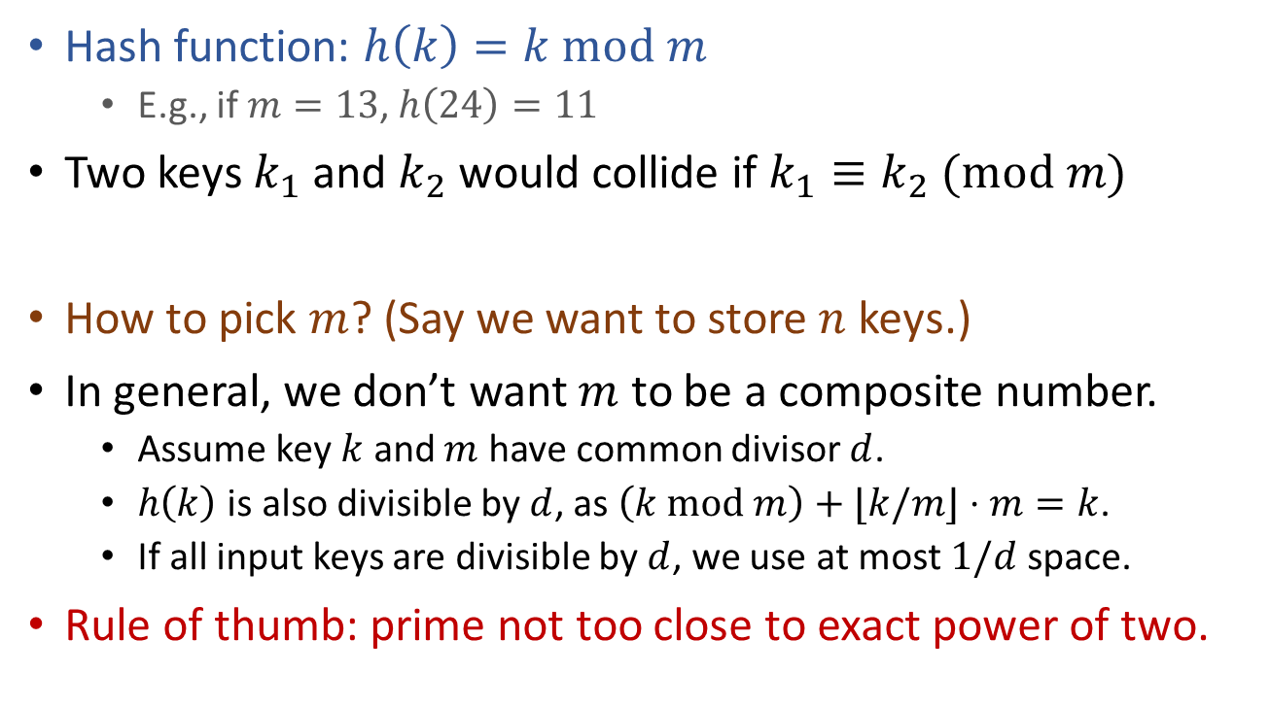
Common technique when designing hash functions The Division Method
Hash function: $h\left(k\right)=k mod m$
E.g., if $m=13$, $h\left(24\right)=11$
Two keys $k_{1}$ and $k_{2}$ would collide if $k_{1}≡k_{2} (mod m)$
How to pick $m$? (Say we want to store $n$ keys.)
In general, we don’t want $m$ to be a composite number.
Assume key $k$ and $m$ have common divisor $d$.
$h\left(k\right)$ is also divisible by $d$, as $\left(k mod m\right)+⌊k/m⌋⋅m=k$.
If all input keys are divisible by $d$, we use at most $1/d$ space.
Rule of thumb: prime not too close to exact power of two.

Slide 22



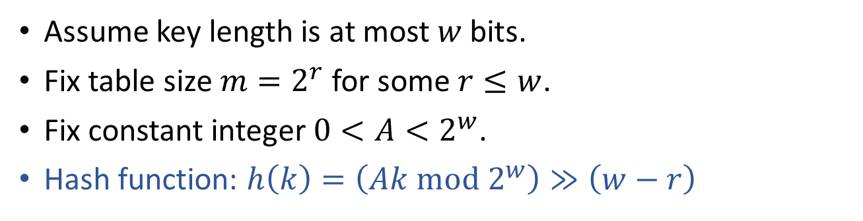



Common technique when designing hash functions The Multiplication Method
Assume key length is at most $w$ bits.
Fix table size $m=2^{r}$ for some $r≤w$.
Fix constant integer $0<A<2^{w}$.
Hash function: $h\left(k\right)=\left(Ak mod 2^{w}\right)≫\left(w−r\right)$
$A$ ($w$ bits)
$k$ ($w$ bits)
$$×$$
$Ak$ ($2w$ bits)
$Ak mod 2^{w}$ ($w$ bits)
$\left(Ak mod 2^{w}\right)≫\left(w−r\right)$ ($r$ bits)

Slide 23
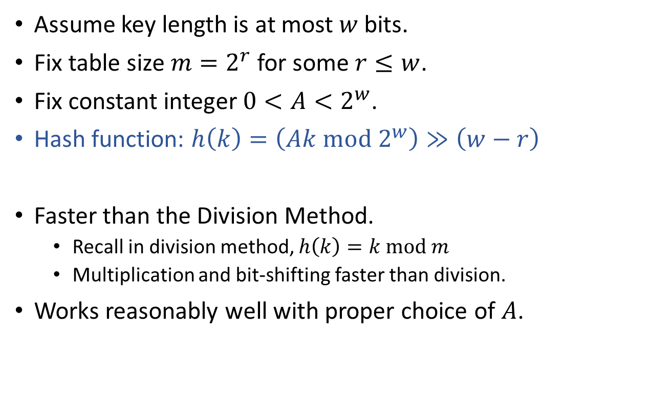
Common technique when designing hash functions The Multiplication Method
Assume key length is at most $w$ bits.
Fix table size $m=2^{r}$ for some $r≤w$.
Fix constant integer $0<A<2^{w}$.
Hash function: $h\left(k\right)=\left(Ak mod 2^{w}\right)≫\left(w−r\right)$
Faster than the Division Method.
Recall in division method, $h\left(k\right)=k mod m$
Multiplication and bit-shifting faster than division.
Works reasonably well with proper choice of $A$.

Slide 24
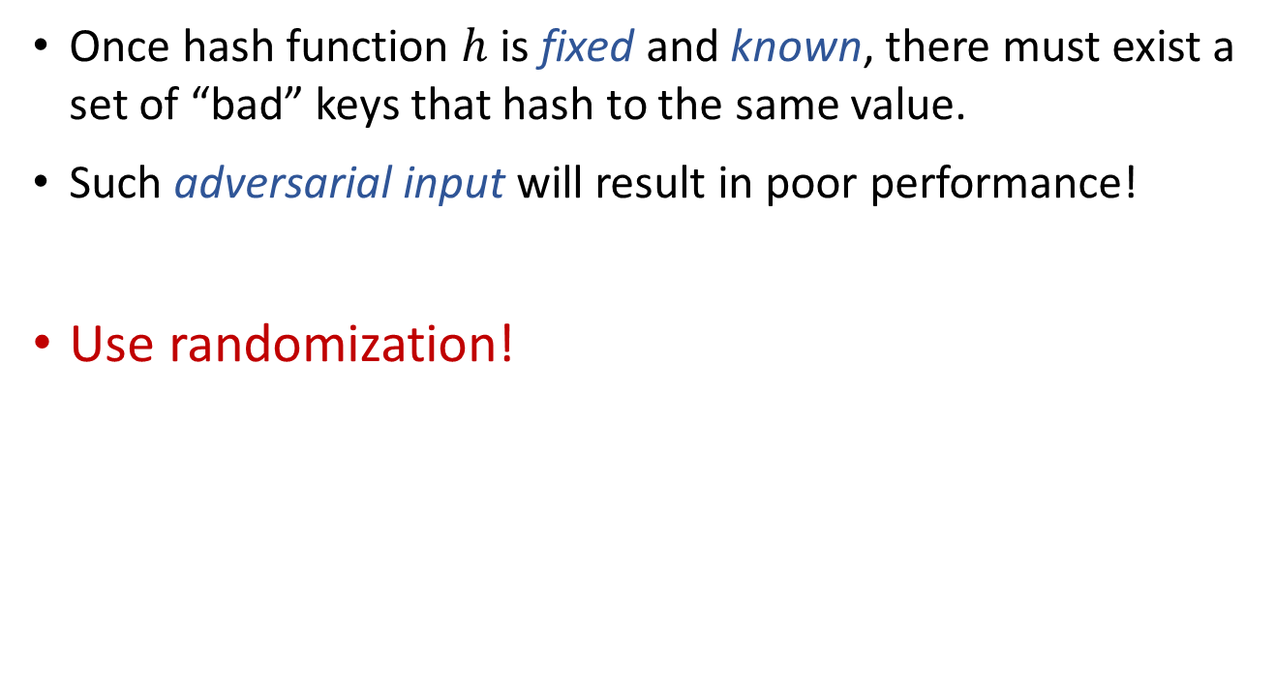
However…
Once hash function $h$ is fixed and known, there must exist a set of “bad” keys that hash to the same value.
Such adversarial input will result in poor performance!
Use randomization!

Slide 25
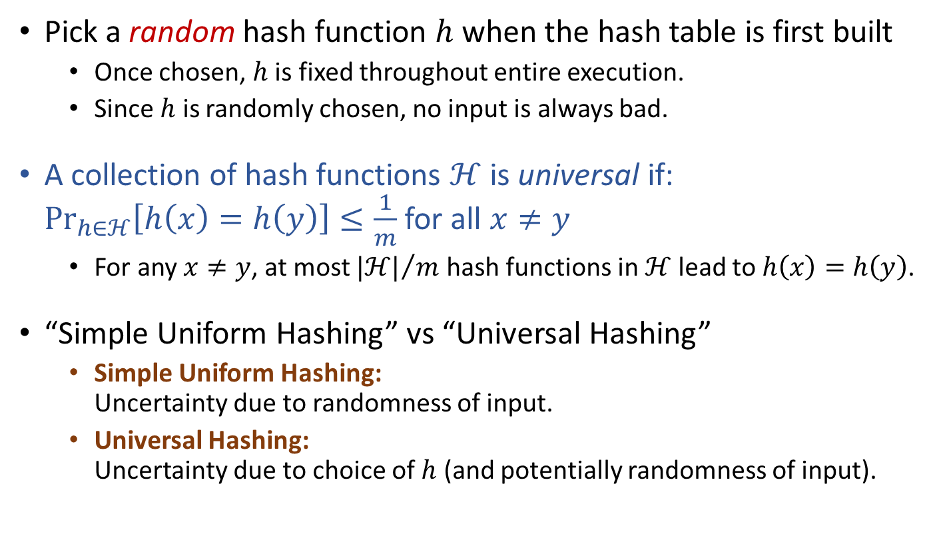
Universal Hashing
Pick a random hash function $h$ when the hash table is first built
Once chosen, $h$ is fixed throughout entire execution.
Since $h$ is randomly chosen, no input is always bad.
A collection of hash functions $ℋ$ is universal if: $\underset{h∈ℋ}{Pr}\left[h\left(x\right)=h\left(y\right)\right]≤\frac{1}{m}$ for all $x≠y$
For any $x≠y$, at most ${|ℋ|}/m$ hash functions in $ℋ$ lead to $h\left(x\right)=h\left(y\right)$.
“Simple Uniform Hashing” vs “Universal Hashing”
Simple Uniform Hashing: Uncertainty due to randomness of input.
Universal Hashing: Uncertainty due to choice of $h$ (and potentially randomness of input).
Notes:
Universal hashing: 全域散列

Slide 26

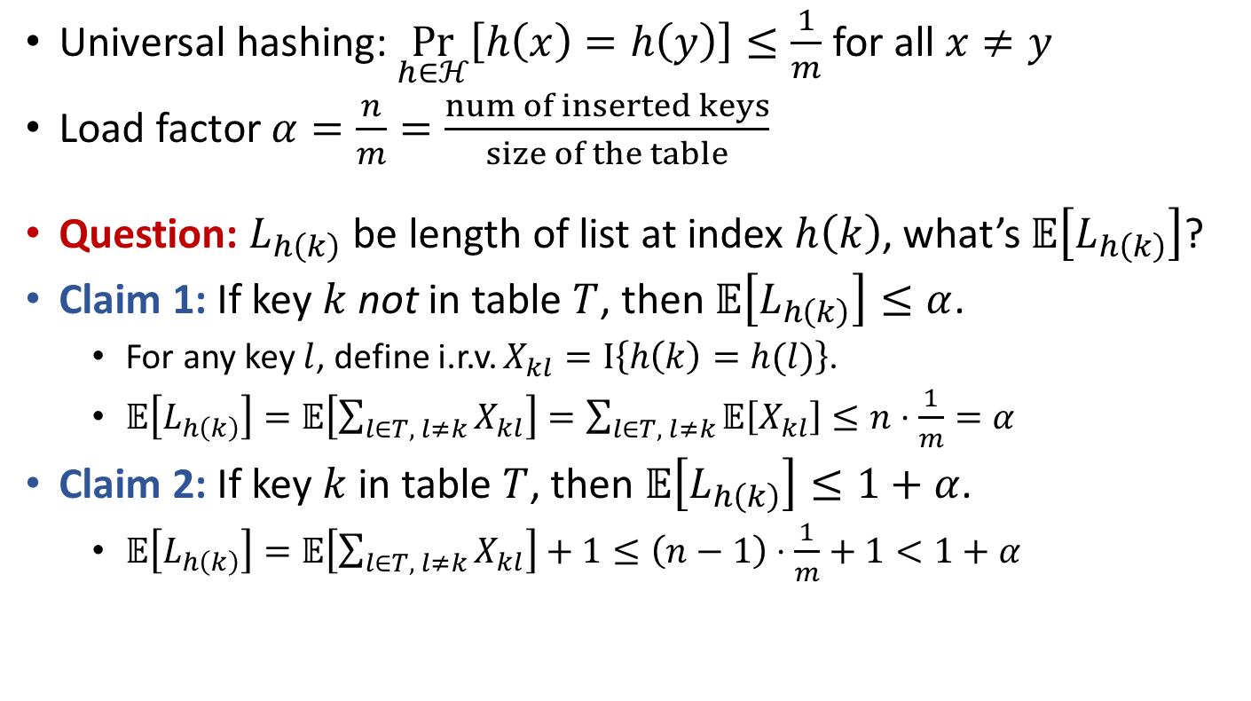
Assuming “Universal Hashing” Performance of hashing with chaining
Universal hashing: $\underset{h∈ℋ}{Pr}\left[h\left(x\right)=h\left(y\right)\right]≤\frac{1}{m}$ for all $x≠y$
Load factor $α=\frac{n}{m}=\frac{num of inserted keys}{size of the table}$
Question: $L_{h\left(k\right)}$ be length of list at index $h\left(k\right)$, what’s $𝔼\left[L_{h\left(k\right)}\right]$?
Claim 1: If key $k$ not in table $T$, then $𝔼\left[L_{h\left(k\right)}\right]≤α$.
For any key $l$, define i.r.v. $X_{kl}=I\left\{h\left(k\right)=h(l)\right\}$.
$𝔼\left[L_{h\left(k\right)}\right]=𝔼\left[\sum_{l∈T, l≠k}{X_{kl}}\right]=\sum_{l∈T, l≠k}{𝔼\left[X_{kl}\right]}≤n⋅\frac{1}{m}=α$
Claim 2: If key $k$ in table $T$, then $𝔼\left[L_{h\left(k\right)}\right]≤1+α$.
$𝔼\left[L_{h\left(k\right)}\right]=𝔼\left[\sum_{l∈T, l≠k}{X_{kl}}\right]+1≤\left(n−1\right)⋅\frac{1}{m}+1<1+α$
If the hash table is not overloaded (i.e., $α=O\left(1\right)$), Search/Insert/Remove can be done in $O\left(1\right)$ expected time.

Slide 27
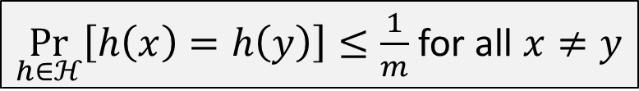
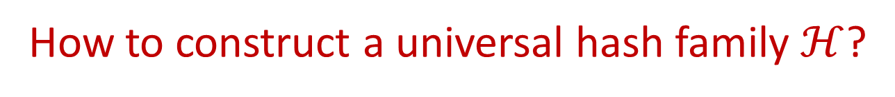
How to construct a universal hash family $ℋ$?
$\underset{h∈ℋ}{Pr}\left[h\left(x\right)=h\left(y\right)\right]≤\frac{1}{m}$ for all $x≠y$
Strictly speaking, the definition here is actually “2-universal hash family”.

Slide 28
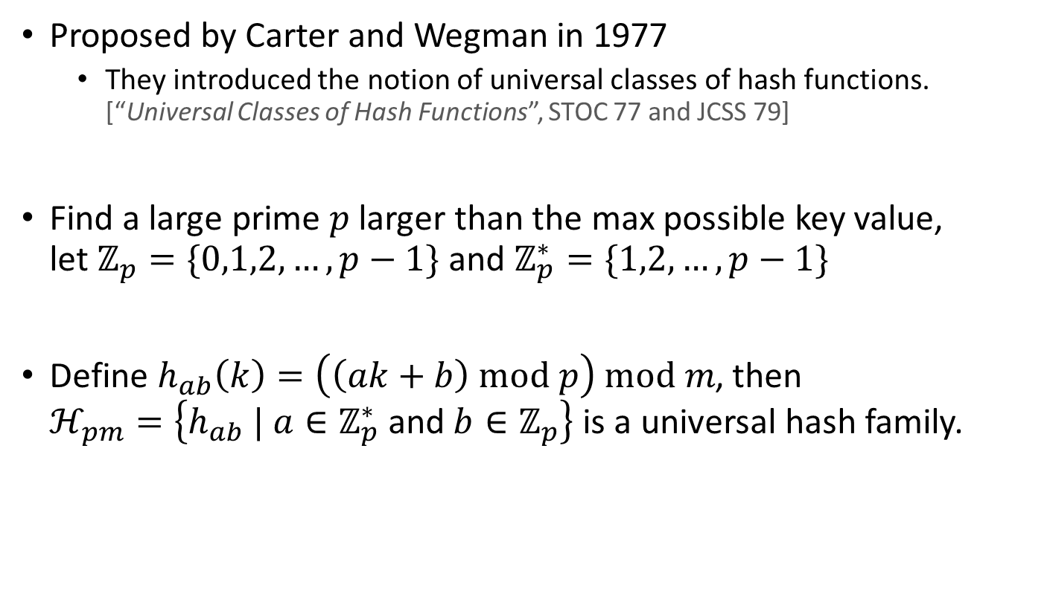
A Typical Universal Hash Family
Proposed by Carter and Wegman in 1977
They introduced the notion of universal classes of hash functions. [“Universal Classes of Hash Functions”, STOC 77 and JCSS 79]
Find a large prime $p$ larger than the max possible key value, let $ℤ_{p}=\{0,1,2,…,p−1\}$ and $ℤ_{p}^{∗}=\{1,2,…,p−1\}$
Define $h_{ab}\left(k\right)=\left(\left(ak+b\right) mod p\right) mod m$, then $ℋ_{pm}=\left\{h_{ab} | a∈ℤ_{p}^{∗} \text{and} b∈ℤ_{p}\right\}$ is a universal hash family.

Slide 29
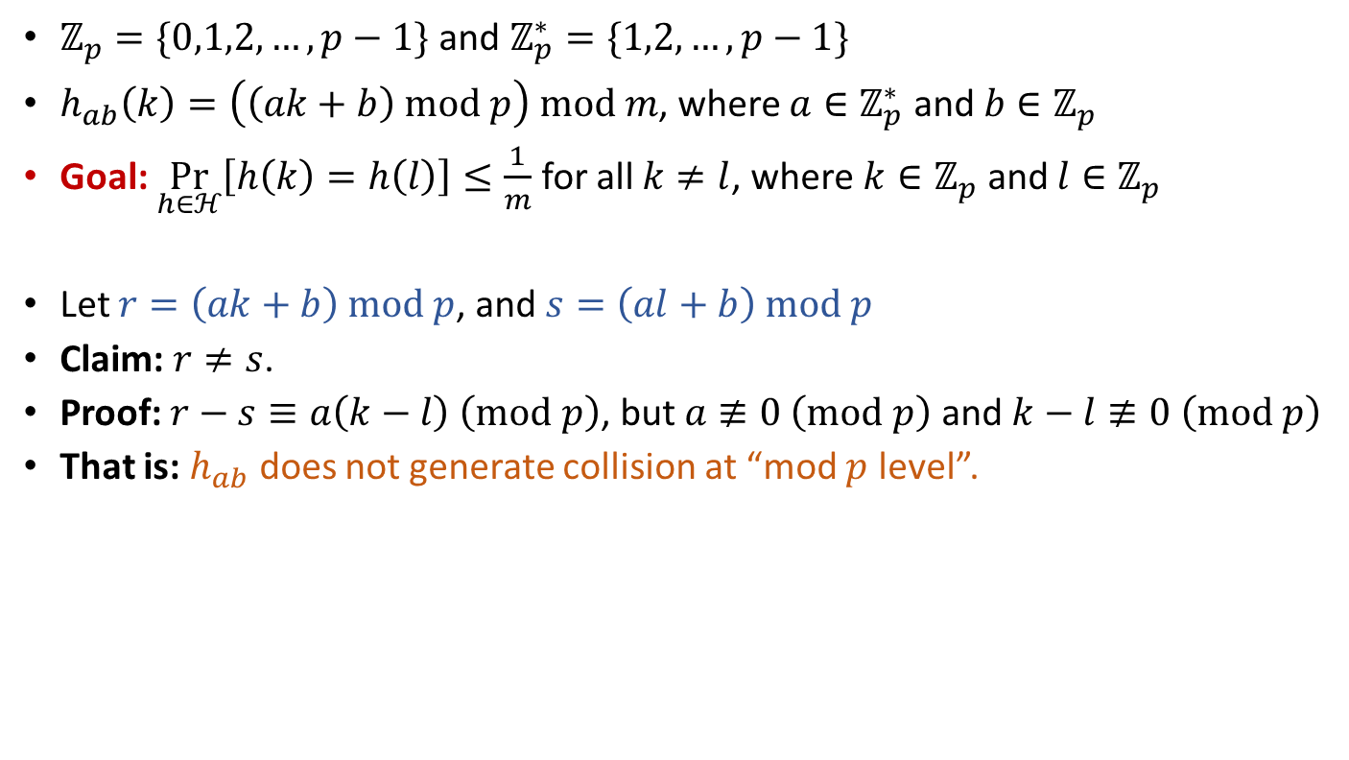
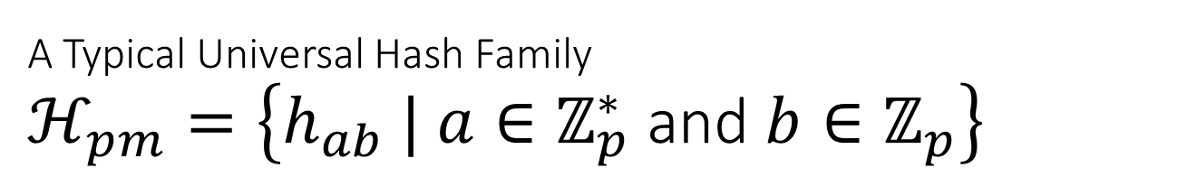
A Typical Universal Hash Family $ℋ_{pm}=\left\{h_{ab} | a∈ℤ_{p}^{∗} \text{and} b∈ℤ_{p}\right\}$
$ℤ_{p}=\{0,1,2,…,p−1\}$ and $ℤ_{p}^{∗}=\{1,2,…,p−1\}$
$h_{ab}\left(k\right)=\left(\left(ak+b\right) mod p\right) mod m$, where $a∈ℤ_{p}^{∗} \text{and} b∈ℤ_{p}$
Goal: $\underset{h∈ℋ}{Pr}\left[h\left(k\right)=h\left(l\right)\right]≤\frac{1}{m}$ for all $k≠l$, where $k∈ℤ_{p}$ and $l∈ℤ_{p}$
Let $r=\left(ak+b\right) mod p$, and $s=\left(al+b\right) mod p$
Claim: $r≠s$.
Proof: $r−s≡a\left(k−l\right) \left(mod p\right)$, but $a≢0 \left(mod p\right)$ and $k−l≢0 \left(mod p\right)$
That is: $h_{ab}$ does not generate collision at “mod $p$ level”.

Slide 30
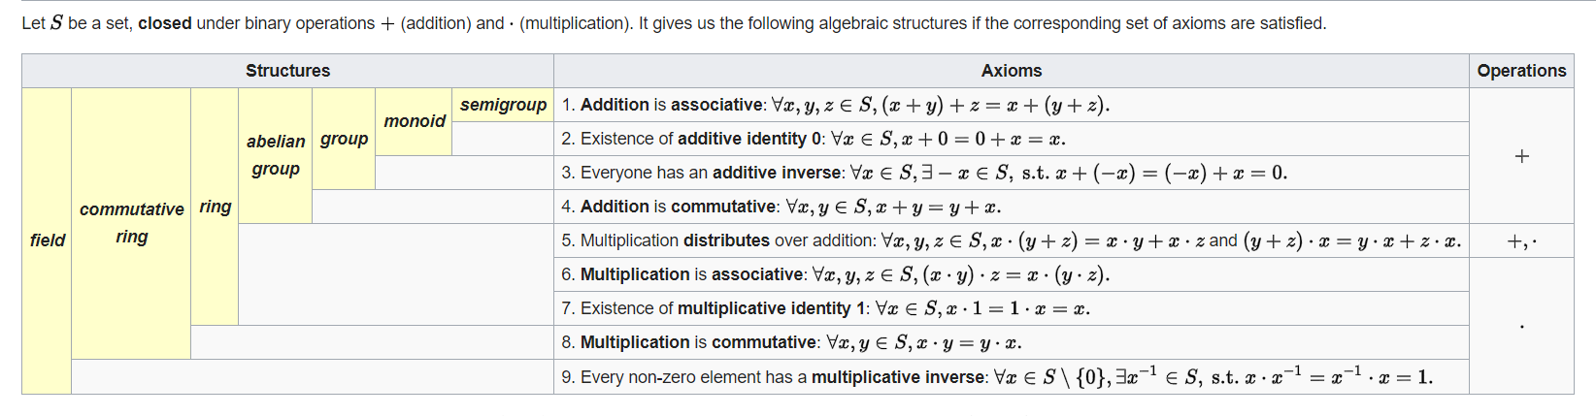


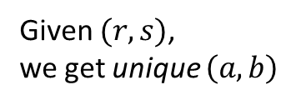
A Typical Universal Hash Family $ℋ_{pm}=\left\{h_{ab} | a∈ℤ_{p}^{∗} \text{and} b∈ℤ_{p}\right\}$
$ℤ_{p}=\{0,1,2,…,p−1\}$ and $ℤ_{p}^{∗}=\{1,2,…,p−1\}$
$h_{ab}\left(k\right)=\left(\left(ak+b\right) mod p\right) mod m$, where $a∈ℤ_{p}^{∗} \text{and} b∈ℤ_{p}$
Goal: $\underset{h∈ℋ}{Pr}\left[h\left(k\right)=h\left(l\right)\right]≤\frac{1}{m}$ for all $k≠l$, where $k∈ℤ_{p}$ and $l∈ℤ_{p}$
Let $r=\left(ak+b\right) mod p$, and $s=\left(al+b\right) mod p$
Claim: $r≠s$. ($h_{ab}$ does not generate collision at “mod $p$ level”)
Claim: Fix $k$ and $l$, there is a 1-to-1 mapping between $\left(a,b\right)$ and $\left(r,s\right)$ pairs.
Recall $r−s≡a\left(k−l\right) \left(mod p\right)$
$a=\left(\left(r−s\right)\left({\left(k−l\right)}^{−1} mod p\right)\right) mod p$
$b=\left(r−ak\right) mod p$
There are $\left(p−1\right)p$ pairs of $\left(a,b\right)$, and $p\left(p−1\right)$ pairs of $\left(r,s\right)$ if $r≠s$.
Unique since $ℤ_{p}$ is a field.
Given $(r,s)$, we get unique $\left(a,b\right)$

Slide 31
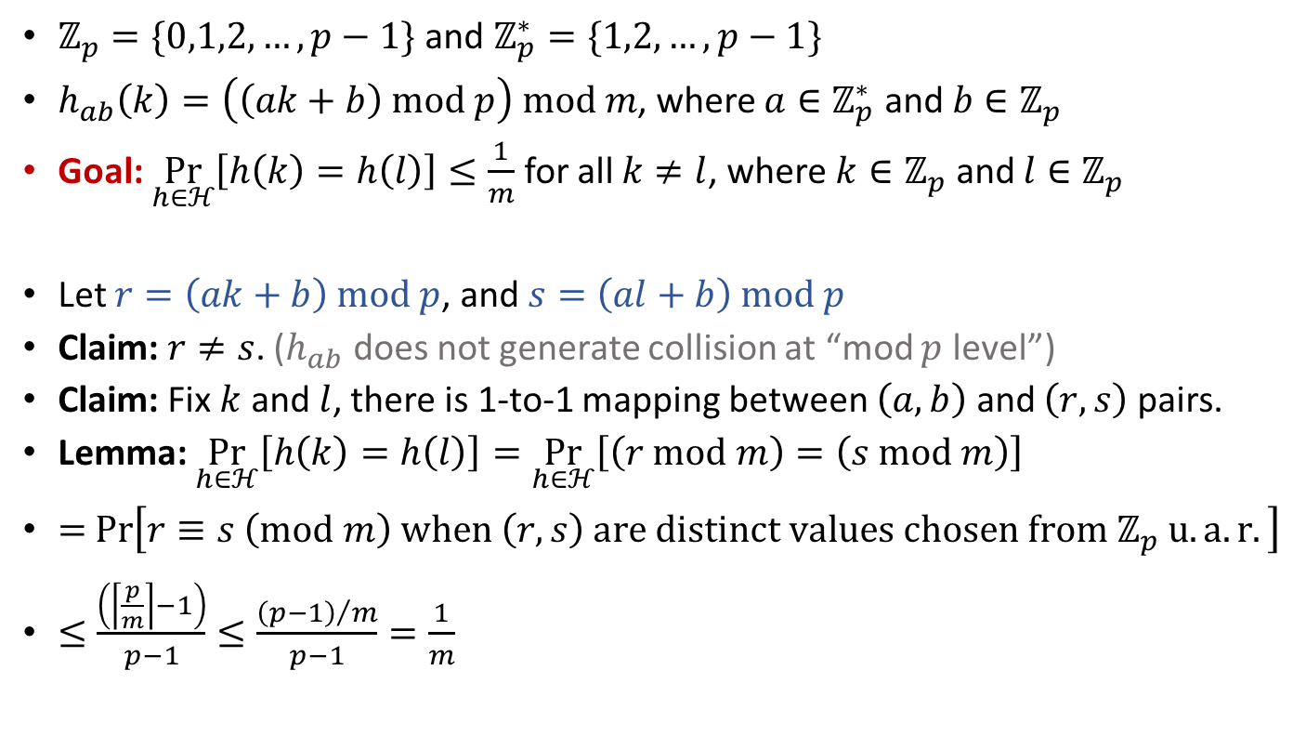
A Typical Universal Hash Family $ℋ_{pm}=\left\{h_{ab} | a∈ℤ_{p}^{∗} \text{and} b∈ℤ_{p}\right\}$
$ℤ_{p}=\{0,1,2,…,p−1\}$ and $ℤ_{p}^{∗}=\{1,2,…,p−1\}$
$h_{ab}\left(k\right)=\left(\left(ak+b\right) mod p\right) mod m$, where $a∈ℤ_{p}^{∗} \text{and} b∈ℤ_{p}$
Goal: $\underset{h∈ℋ}{Pr}\left[h\left(k\right)=h\left(l\right)\right]≤\frac{1}{m}$ for all $k≠l$, where $k∈ℤ_{p}$ and $l∈ℤ_{p}$
Let $r=\left(ak+b\right) mod p$, and $s=\left(al+b\right) mod p$
Claim: $r≠s$. ($h_{ab}$ does not generate collision at “mod $p$ level”)
Claim: Fix $k$ and $l$, there is 1-to-1 mapping between $\left(a,b\right)$ and $\left(r,s\right)$ pairs.
Lemma: $\underset{h∈ℋ}{Pr}\left[h\left(k\right)=h\left(l\right)\right]=\underset{h∈ℋ}{Pr}\left[\left(r mod m\right)=\left(s mod m\right)\right]$
$=$ $\operatorname{Pr}\left[r≡s \left(mod m\right) when \left(r,s\right) are distinct values chosen from ℤ_{p} u.a.r.\right]$
$≤\frac{\left(\left\lceil \frac{p}{m}\right\rceil −1\right)}{p−1}≤\frac{{\left(p−1\right)}/m}{p−1}=\frac{1}{m}$

Slide 32
Reading
[CLRS] Ch.11 (11.1-11.3)

